Slide 1
SUPPLY CHAIN PROJECT
Vikram Reddy
DSBA_March,2023

Slide 2
BUISNESS PROBLEM
A FMCG company has entered into the instant noodles business two years back.
It is observed that there is demand & supply mismatch of noodle packages which were sent to the Warehouses.
Notes:
Basically there is an Inventory LOSS

Slide 3
GOAL
Predict the Optimum Weight of the product that need to be shipped to Warehouse.
Identify different demand patterns emerging from the data and also identifying most important features.

Slide 4
UNDERSTANDING THE DATA
Types of Data.
Nominal Data ➔ (Location type , Zone ….)
Ordinal Data ➔ (WH_capacity_size..)
Discrete Data ➔ (number of workers…)
Continuous Data ➔(ProductWeight & Distance hub)
No Duplicates
Null values were Present

Slide 5
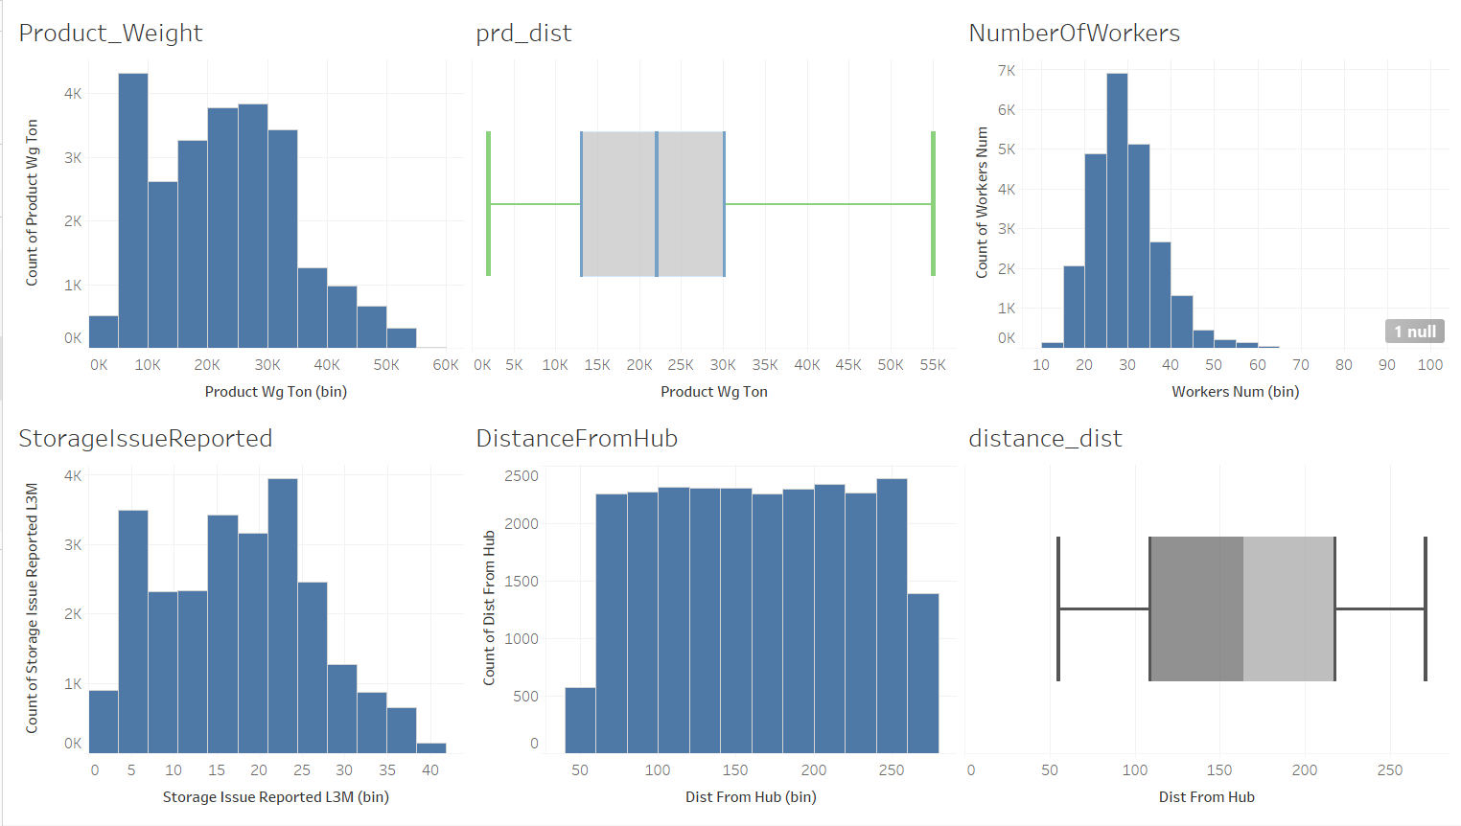
EDA -- UNIVARIATE ANALYSIS

Slide 6
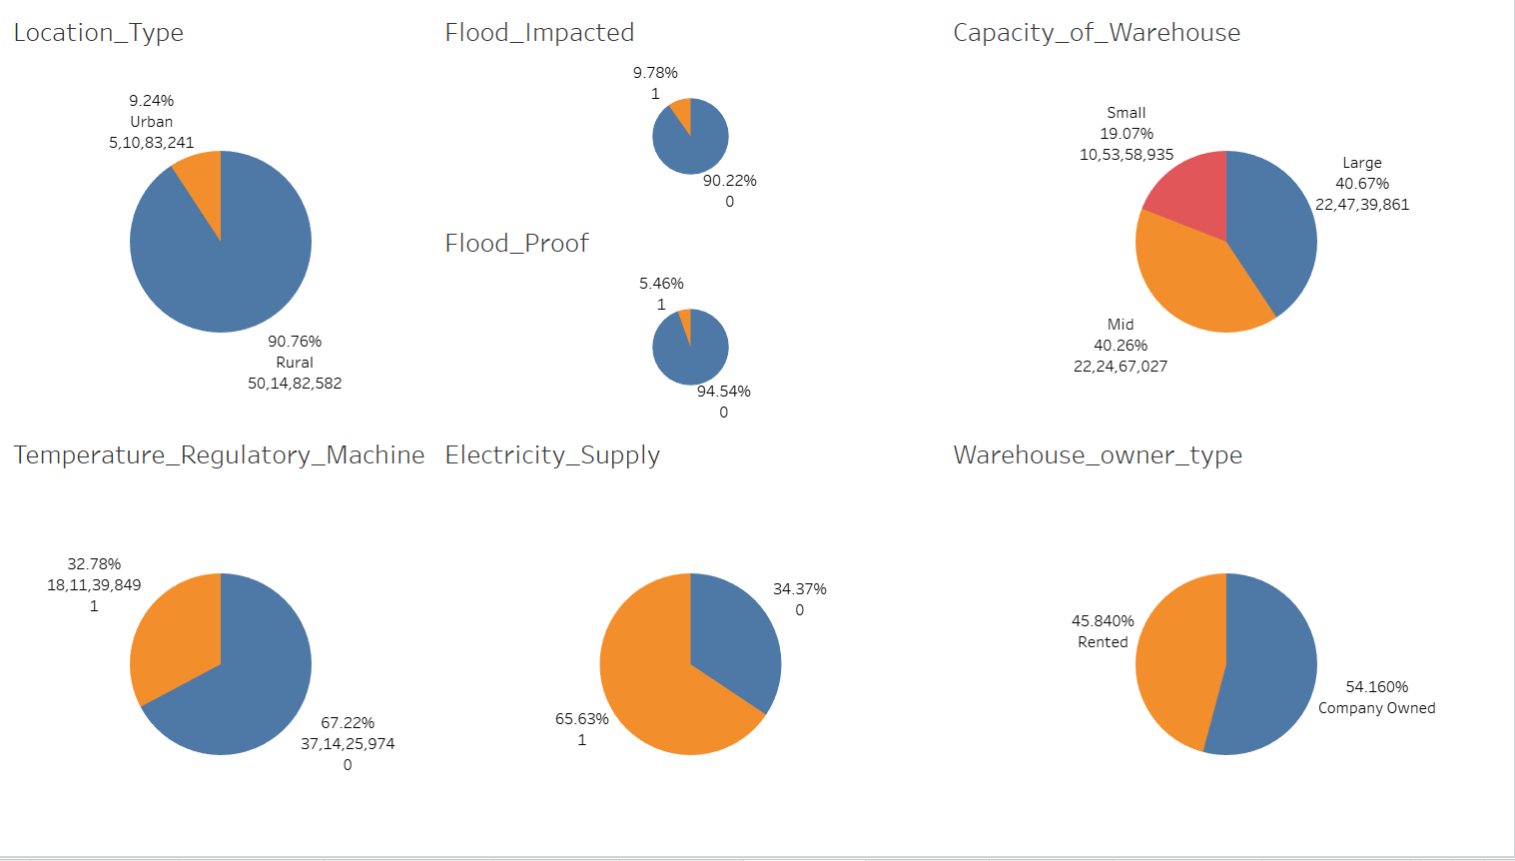
EDA -- UNIVARIATE ANALYSIS

Slide 7
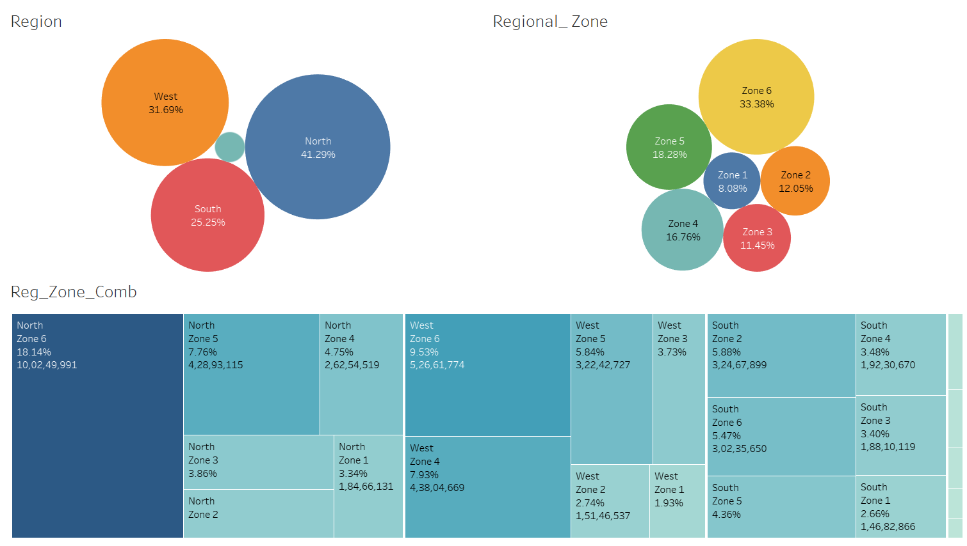
EDA -- UNIVARIATE ANALYSIS

Slide 8
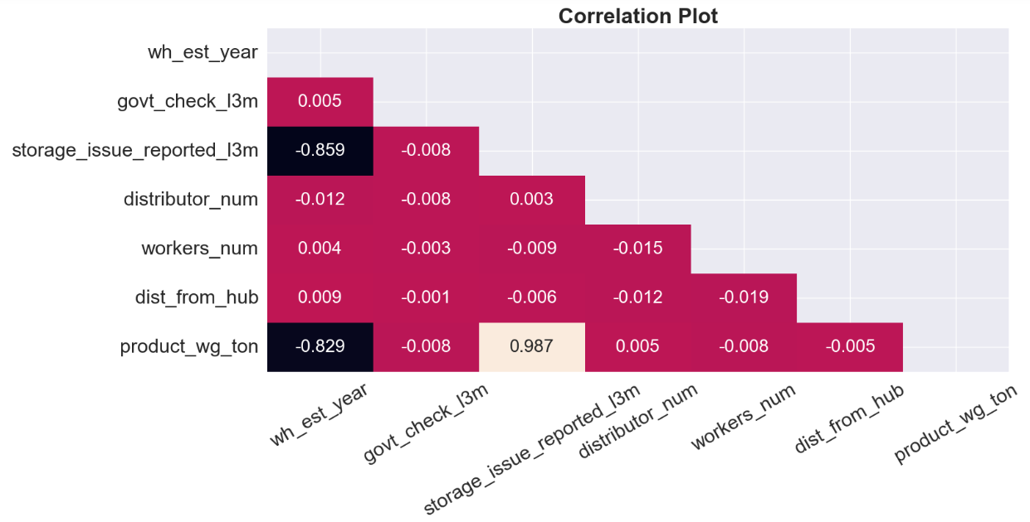
EDA -- CORRELATION

Slide 9
EDA -- CORRELATION

Slide 10
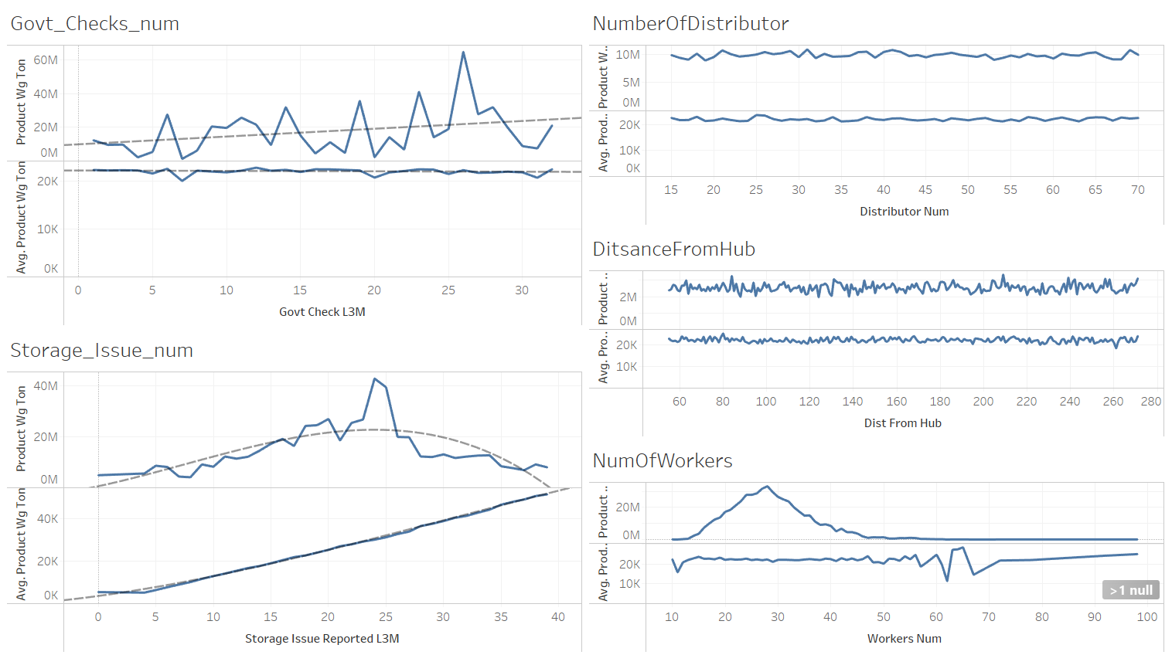
EDA – DISCRETE DATA VS PRODUCT WEIGHT
Notes:
The mean of product weight of storage issues is following linear relation ship

Slide 11
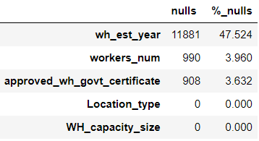
MODELLING APPROACH
Preparing the Data
Label Encoding the data
Null Values & KNN Imputation
Dropping “wh_est_year”
Train Test Split 70:30

Slide 12
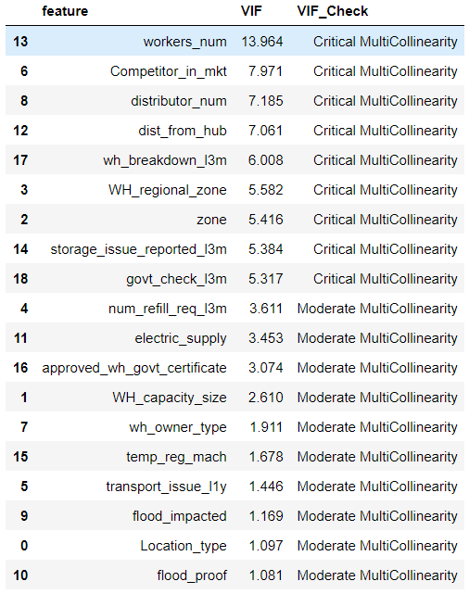
MODELLING APPROACH
Multi Collinearity Check
Strong Multicollinearity presence, meaning good amount of non linearity in data among the columns.
Notes:
There is good amount of multicollinearity, so there lot of non linearity in the model

Slide 13
MODELLING APPROACH
ML Modelling
LinearRegression → GLM
RandomForestRregressor → Bagging Model
XGBoostRregressor → Boosting Model
MLPRregressor → Neural Network Model
GrisSearvchCV→ CrossValidation & HyperParameter Tuning
SHAPLEY→ feature Importance’s, SFS
Metrics for validation→ R-Squared, RMSE, MAPE

Slide 14
SUMMARY OF RESULTS
ML Model | Metrics | TRAIN | TEST | fit_%
Linear Regression | R-Squared | 0.977 | 0.978 | 0.10%
Random Forest Regressor | R-Squared | 0.995 | 0.994 | 0.10%
XGBoost Regressor | R-Squared | 0.995 | 0.994 | 0.10%
MLP Regressor | R-Squared | 0.993 | 0.993 | 0.00%
ML Model | Metrics | TRAIN | TEST | fit_%
Linear Regression | RMSE | 1748.132 | 1692.693 | 3.17%
Random Forest Regressor | RMSE | 852.301 | 893.355 | 4.82%
XGBoost Regressor | RMSE | 852.986 | 869.539 | 1.94%
MLP Regressor | RMSE | 941.458 | 970.665 | 3.10%
ML Model | Metrics | TRAIN | TEST | fit_%
Linear Regression | MAPE | 8.80% | 8.69% | 1.27%
Random Forest Regressor | MAPE | 4.00% | 4.22% | 5.63%
XGBoost Regressor | MAPE | 4.06% | 4.21% | 3.64%
MLP Regressor | MAPE | 4.68% | 4.87% | 3.93%
Notes:
Xgboost regressor was least in over & under fitting

Slide 15
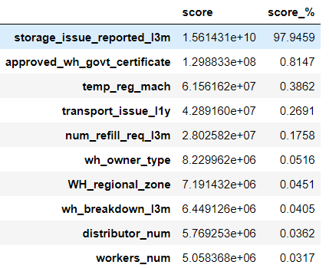
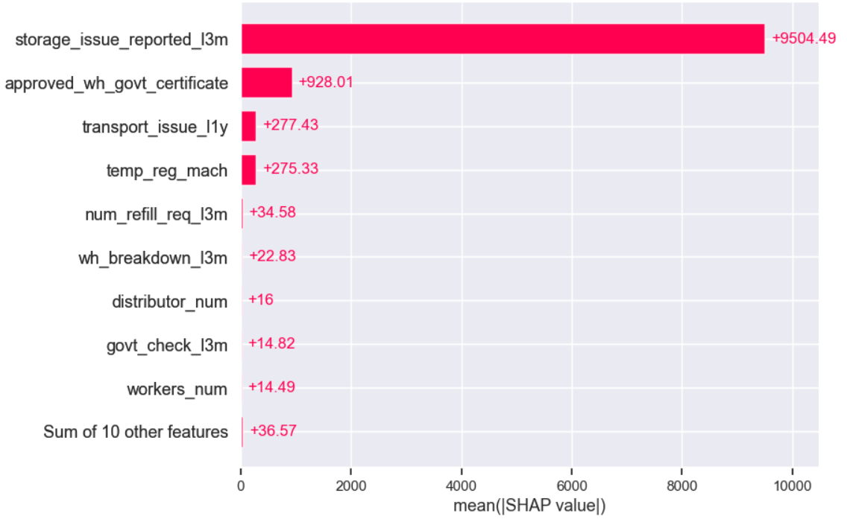
Most Important Features
Feature Imp XGB
Shapley

Slide 16
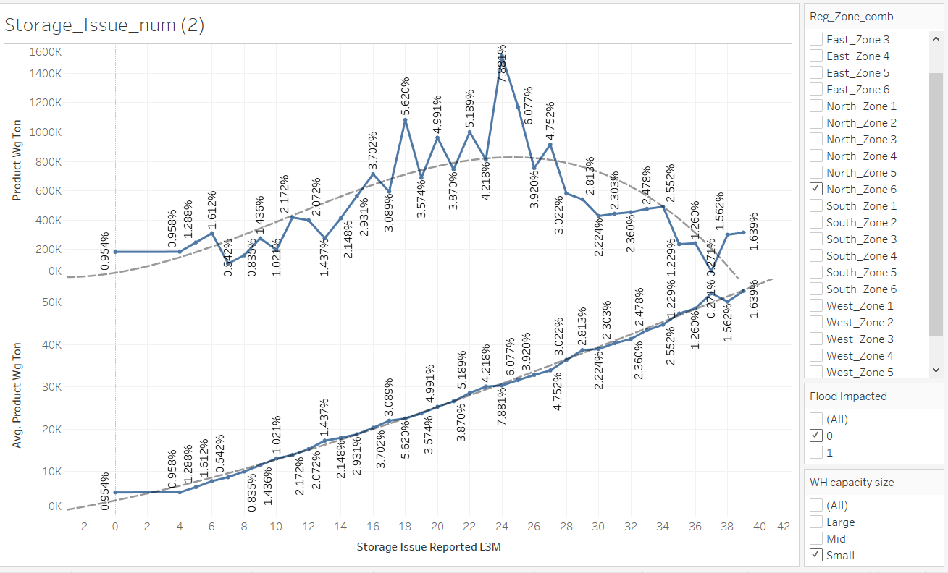
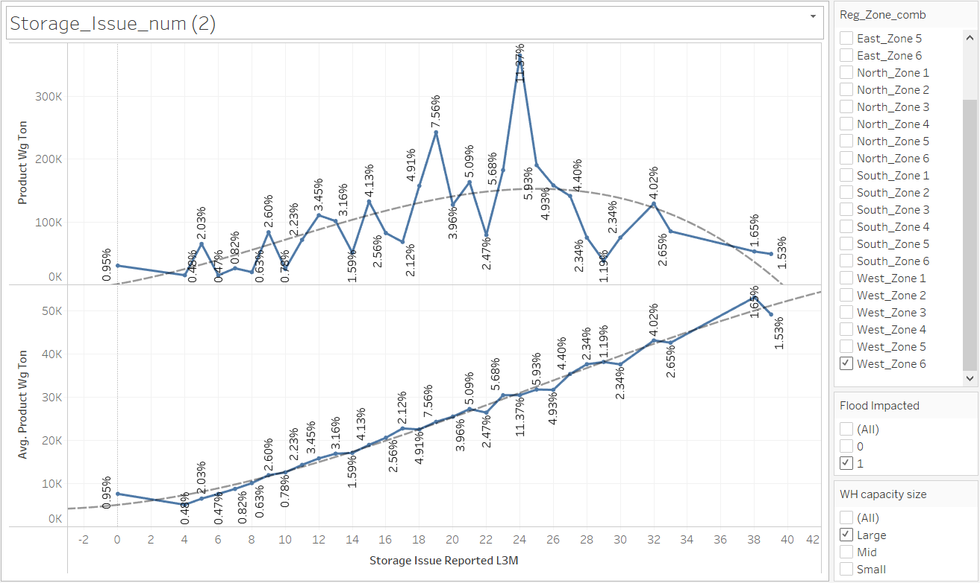
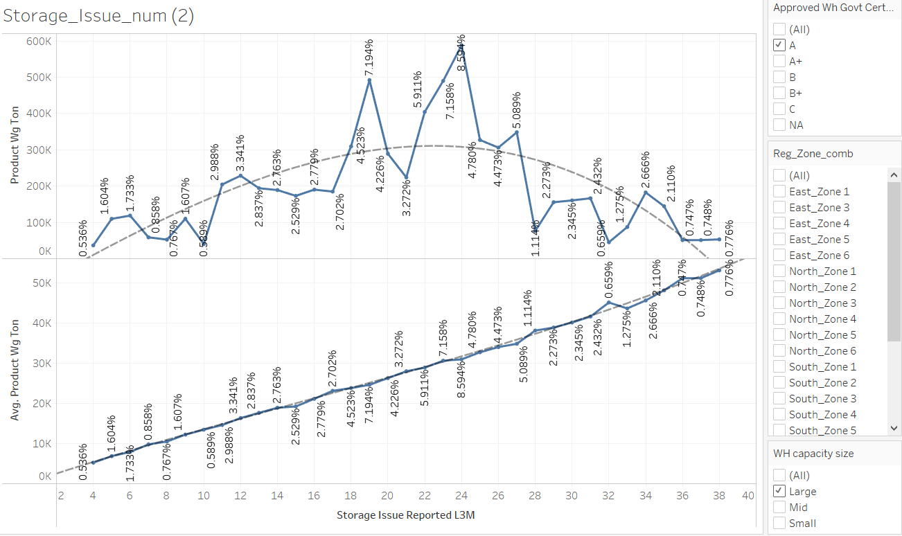
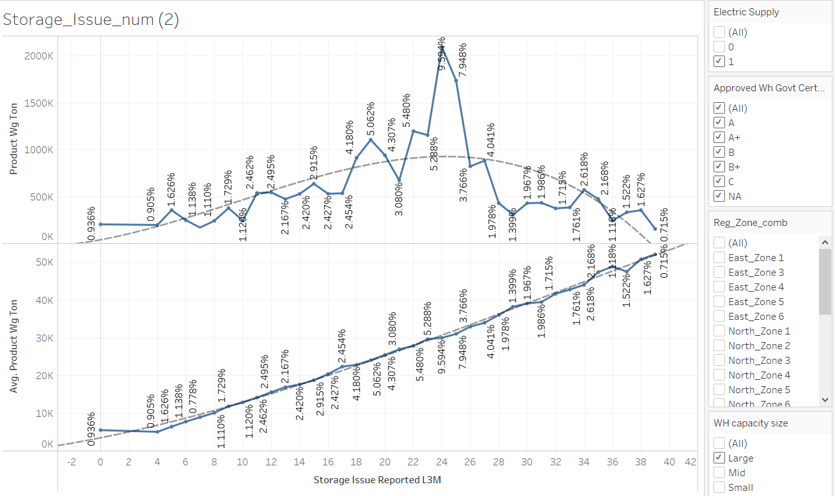
STORAGE ISSUE REPORTED
INSIGHTS FROM ANALYSIS
Same Pattern across categories
Notes:
SAME PATTERN FOR DIFFERENT CATEGORICAL SELECTION

Slide 17
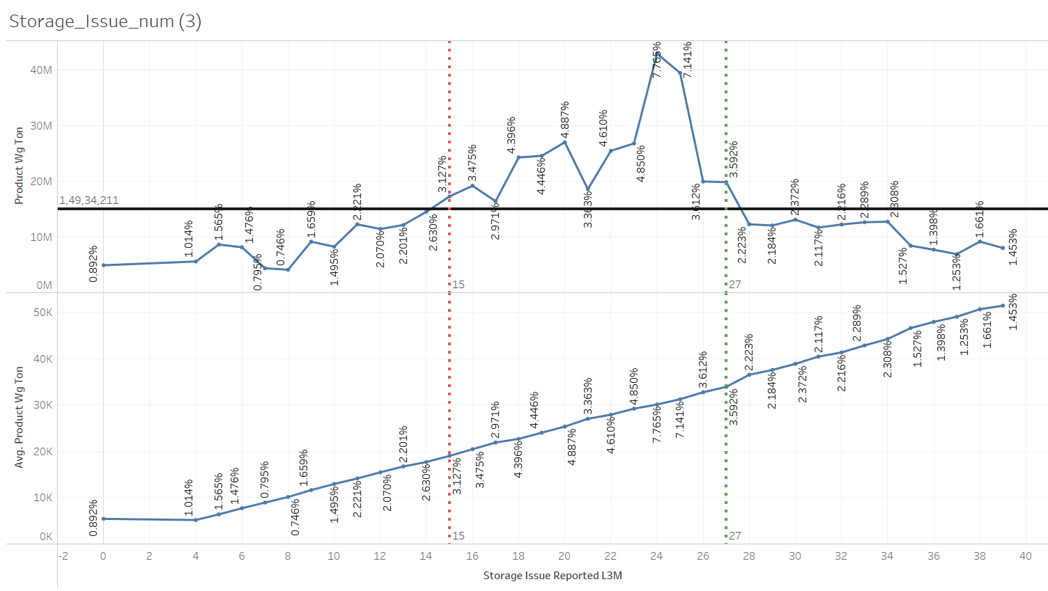
STORAGE ISSUE REPORTED
INSIGHTS FROM ANALYSIS
Warehouse reported storage issue to corporate office in last 3 months. Like rat, fungus because of moisture etc.
Inventory Loss
Overloading
Inventory Loss
Increase in mean Weight
Notes:
As the number of storage issues increases the mean weight of the product increases.
15 to 27 number of storage issues appears to be overloading.

Slide 18
RECOMMENDATIONS
Top Priority to reduce number of Storage Issues
Machine sensors for detecting temperature, moisture & potential pests.
Designing a proper Architecture of Warehouse based on current Storage Issues.
Assurance of Safety Standards, Health & Hygiene of Warehouse
More specific data of storage is to be collected like type, magnitude & frequency of issues etc.

Slide 19
RECOMMENDATIONS
Immediate checkup of Warehouses with storage issues 15 to 27 for Overloading.
Run Xgboost model to predict optimize weight for given storage issues.
Target Rural areas which is 90% of revenue.
Target North/West Zone5,6 which is 50% of revenue

Slide 20
Thank You

